Slide 1
ENGI 301 Perfect Coffee Project (PCB)
10/04/2018
Alvaro Castillo

Slide 2
Background Information
One of the worst things that can happen to you while working is to realize that your coffee is either to hot or to cold.
This project aims to solve this issue by letting the person know when the coffee is to hot and by heating the coffee in case it gets to cold.
LED lights that tell you if the coffee is too cold or too cold
Heating pad that warms the coffee up to a desired temperature
Potentiometer to select desired temperature
Hex Display will show the desired temperature

Slide 3
Functional Block Diagram Option
Set desired temperature
Check with desired value
How high?
Higher Value
Close to desired value
Measure Temperature
Far from desired value
Lower
Value
Turn on green LED
Turn on heating mat
Turn on blue LED
Turn on red LED

Slide 4
System Block Diagram
LEDs
Thermistor
Heating Mat
Transistor
PocketBeagle
GPIO
SPI0
Hex Display
Power source (5V)
USB0
AIN
Potentiometer

Slide 5
Power Block Diagram
12V Battery
PocketBeagle
5V
~500mA
Transistor
Heating mat
SYS_VOUT
3.3V
LEDs
(~20mA)
SYS_VDD1_3P3V
12V to 5V Converter
Hex Display
(~100mA)
Thermistor (~2mA)
5V
~500mA
USB (from converter)
VIN_USB
1.8V
Potentiometer
SYS_VDD_1P8V

Slide 6
Components & Dimensions
Component | Manufacturer | Dimensions
Electric Heating Pad | Adafruit | 10cm x 5cm
Thermistor (DS18B20) | Adafruit | 91cm long, 0.4cm diameter
Red LED | Generic | 0.5cm diameter
Green LED | Generic | 0.5cm diameter
Blue LED | Generic | 0.5cm diameter
Potentiometer | Benteng | 0.4cm x 0.9cm
Hex Display | Adafruit | 2.7cm x 5cm x 0.4mm
Diode | Generic | 0.6cm x 0.2cm diameter
PocketBeagle | BeagleBone | 5.6cm x 3.5cm x 0.5cm
Resistors | Generic | 0.6cm x 0.2cm diameter
Transistor (TIP32C) | STMicrolectronics
12V to 5V Converter | Adafruit | 1.9cm x 3.2cm

Slide 7
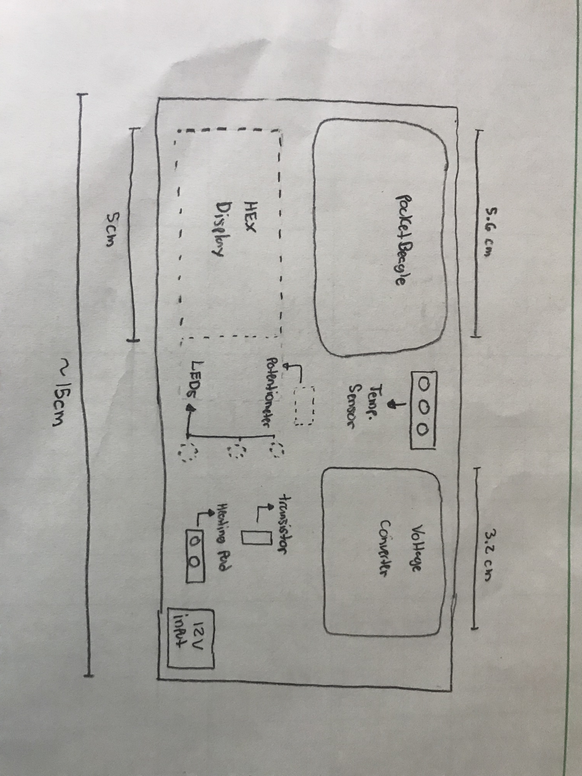
Component Diagram

